Slide 1
First Mentor Demo
Norbert Szücs – prejunior PLC programmer

Slide 2
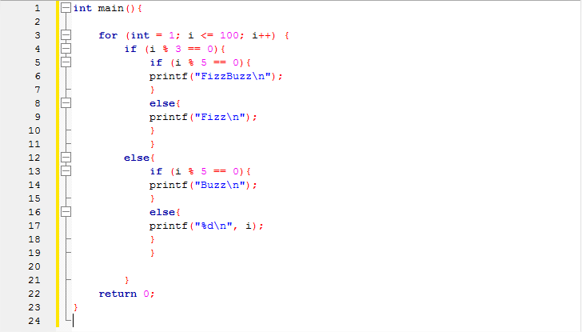
FizzBuzz case 1

Slide 3
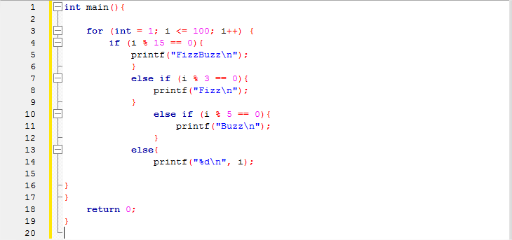
FizzBuzz case 2

Slide 4
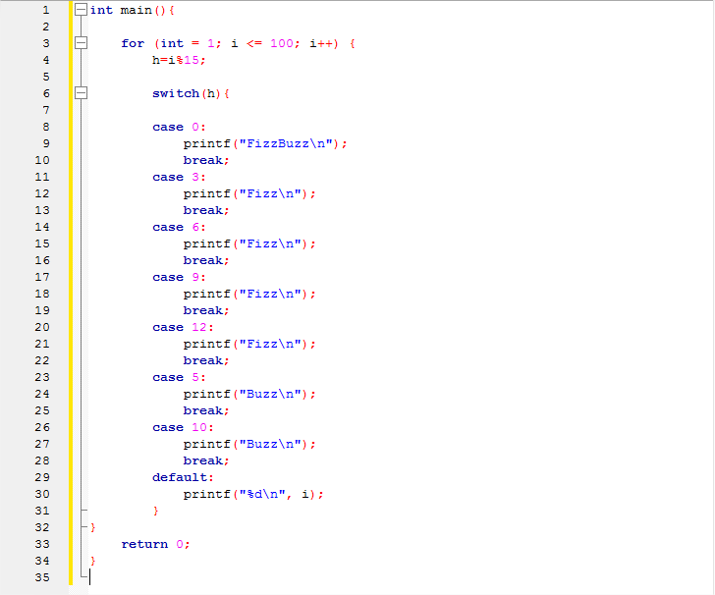
FizzBuzz case 3

Slide 5
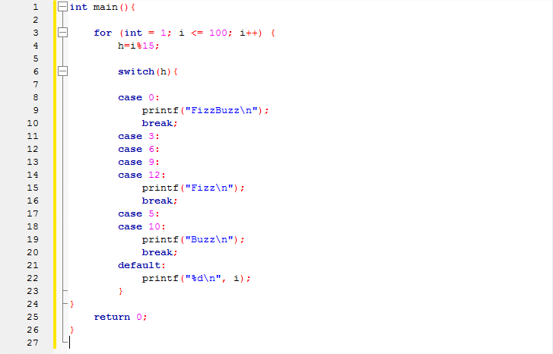
FizzBuzz case 4

Slide 6
Sorry for breaking our C guideline I will try harder!

Slide 7
Questions?

Slide 8
Thanks for your attention!

